Slide 2
SECURITY CHALLENGES IN SMART CONTRACTS
Lucas pelloni
Ile cepilov

Slide 3
Content
What is a Blockchain?
What is a Blockchain?
How does it work?
Benefits of Blockchain Technology
Blockchain applications
Smart Contracts
What is a Smart Contract?
Traditional Contract vs. Smart Contract
What goes into a Smart Contract
Possible applications
Ethereum, Blockchain-based Application

Slide 4
Content
Security Challenges in Smart Contracts
asf

Slide 5
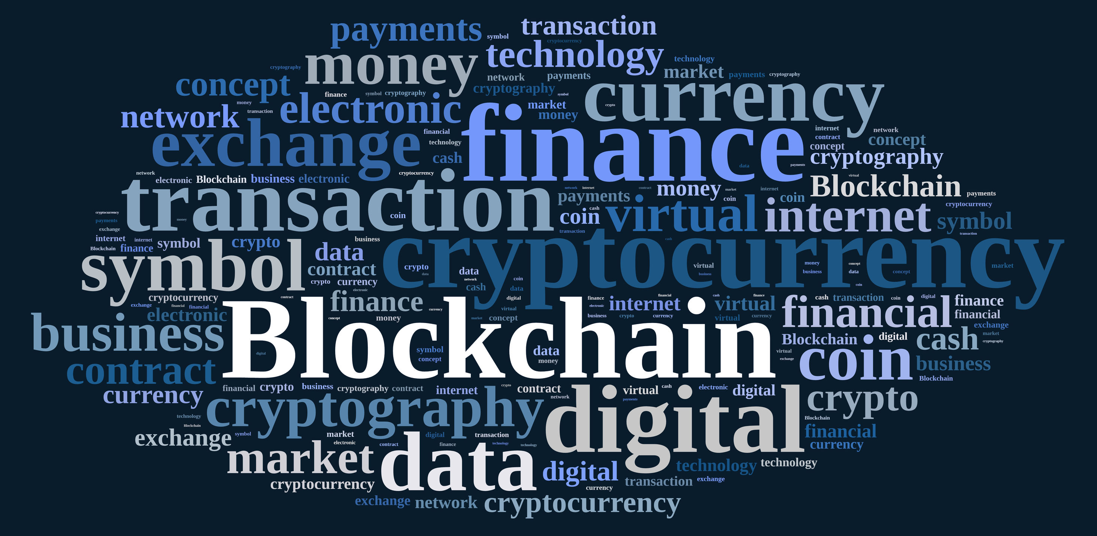
2. Blockchain technology
What is a Blockchain?
How does it work?
Benefits of Blockchain Technology
Blockchain applications

Slide 6
2.1 What is a blockchain?
Distributed Database
Public digital ledger
Source of Trust
Notes:
DISTRIBUTED DB
Blockchain technlogy is challenging the status quo in a radical way, by using math and cryptogrnaphy.
Blochchain provides an open decentralised database of every transaction involing value (Money, goods, property word or even votes)
Basically, a BC is an append-only data structure mainteined by the nodes of a peer-to.peer network
Creating a record whose authenticity can be verified by the entire community -> Thirty part trust organisations may no longer be necessary
PUBLIC LEDGER
Every transaction will be recorded on a public and distributed ledger
SOURCE OF TRUST
Blockchain will become a global decentralised source of trust
Everything that is centralized makes it easy to attack because it offers a single point of failure.
(e.g. Firewall of a website).
Application built with Bloch chain technlogy do not require users to trust the developers with personal information or funds.
Currently, most people use a trusted middleman such as a bank to make a transaction. But blockchain allows consumers and suppliers to connect directly, removing the need for a third party.

Slide 7



2.2 How does blockchain work?
Notes:
Alice wants to buy a product from bob’s store and she wants cryptovalues (e.g. bitcoins)

Slide 8


2.2 How does blockchain work?
Notes:
The transaction can be represented online as a ‘block’

Slide 9




2.2 How does blockchain work?
Notes:
The block (resp. the transaction) is broadcast across the entire network

Slide 10

2.2 How does blockchain work?
Notes:
Which validates it

Slide 11
2.2 How does blockchain work?
Notes:
The block is then added to the chain which records the entire NON-reversible (indelible) history of transactions in a public ledger

Slide 12
2.2 How does blockchain work?
Notes:
The money moves from Alice to Bob

Slide 13
2.3 Benefits of blockchain
Decentralization of technology
Transactions are immutable
Distributed shared Ledger
… but there are also some hurdles ...
Notes:
No middleman (transactions between users are instantaneous)
A centralized system it’s easier to attack.
For Example if you have to execute a transaction through a bank you have to pay a fee for it, whereas using blockchain technology you don’t have to pay
------------------------------------------
Transactions are not prone to third part interference
--------------------------------------------------------------------------
The transactions data, are available online to everyone on the distributed shared ledger

Slide 14
2.4 Blockchain applications
Decentralized exchanges (e.g. Bitcoin)
Encrypted cloud storage (e.g. Storj)
Digital identity
And also . . .
Notes:
One of the most famous blockchain application is the transfer of bitcoins used for online trades.
2. Cloud shared by the community (where each file is shredded and encrypted and spread across the network)
3. Blockchain application can be applied to identity applications, like Passports, Birth Certificates, IDs, Online accounts, and so on

Slide 15
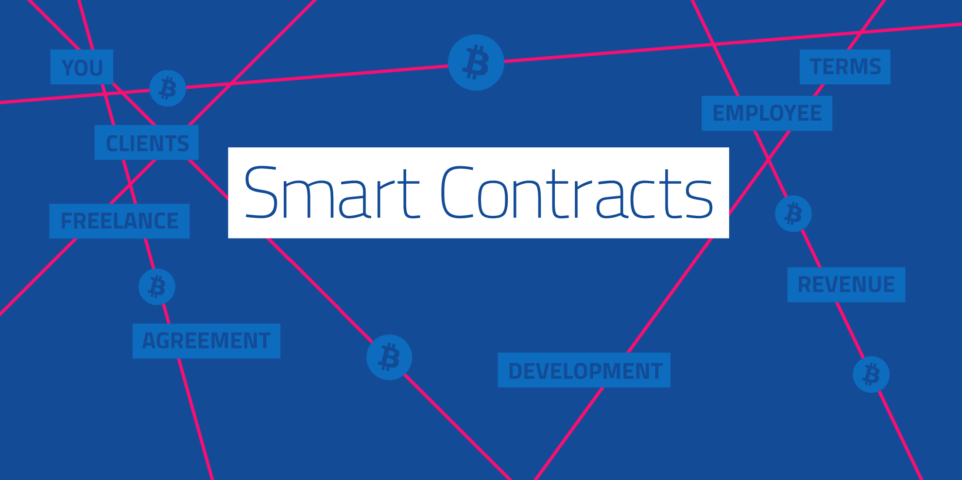
Notes:
Think of it as wills and contract that execute themselves

Slide 16
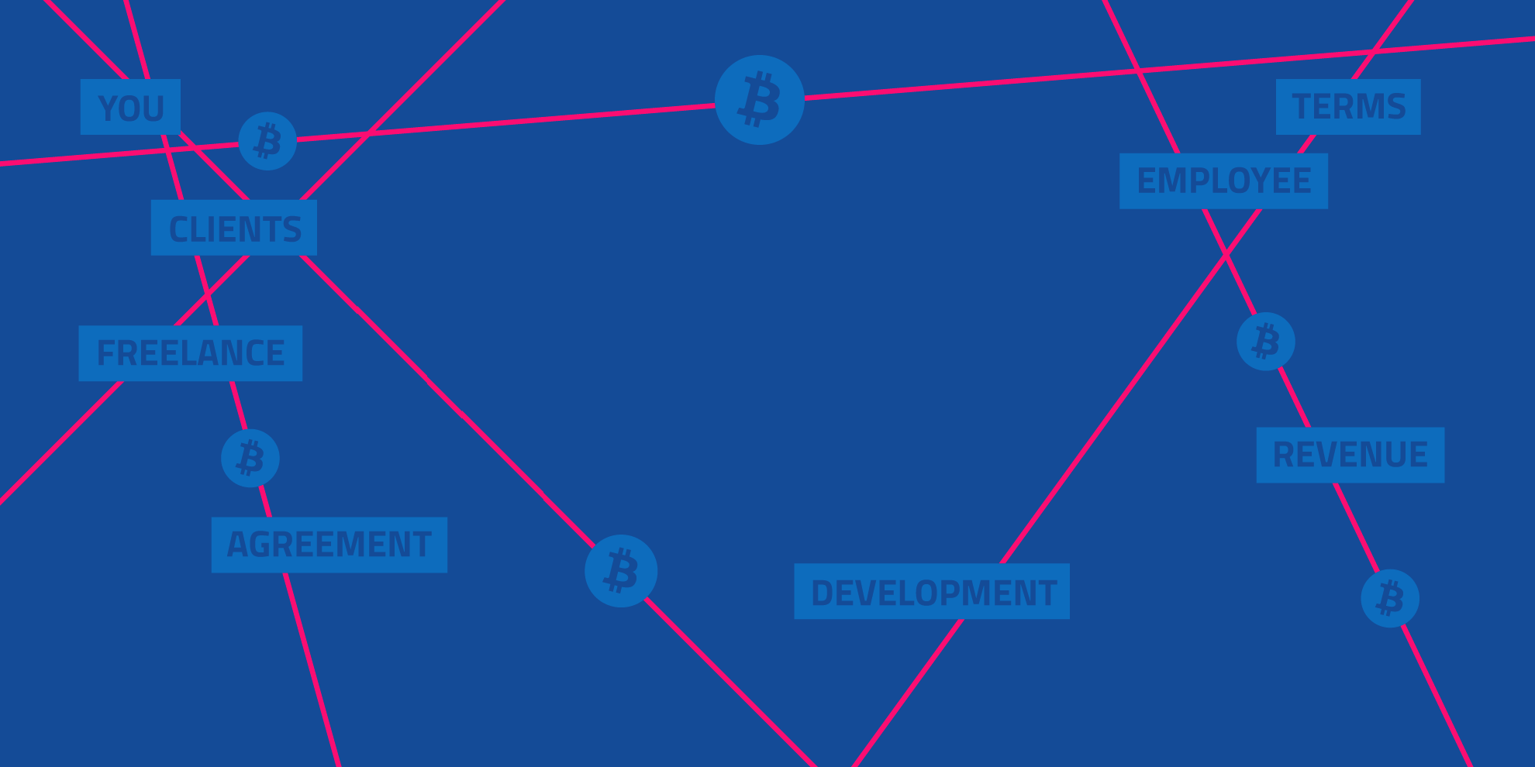
3. Smart Contracts
What is a Smart Contract?
Traditional Contract vs. Smart Contracts
What goes into a Smart Contract?
Possible applications
Ethereum, Blockchain-based Platform
Notes:
Think of it as wills and contract that execute themselves

Slide 17
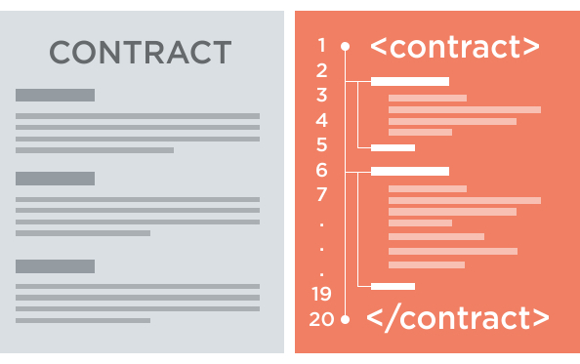
3.1 What is a smart contracT?
A smart contract is a piece of software that defines the rules of an agreement
It automatically verifies itself and executes the terms contained inside it
Stored on the Blockchain
Notes:
A SC is a piece of software that stores rules for negotiating the terms of a contract, automatically verifies the contract and then executes the agreed terms.
Smart contracts are computer programs that can be correctly executed by a network of mutually distrusting nodes, without the need of an external trusted authority, which means that are the nodes the “autorithy”, who validates the valid execution of a smart contract
Encrypted and Stored on the blockchain
To append a new block of data (the code for the execution of a SC) to the blockchain, the miners have to validate the exectuion of the SC
SC are stored on the blockchain which all parties have a copy of and if any party fails the system continues to functions with no loss of data or integrity

Slide 18

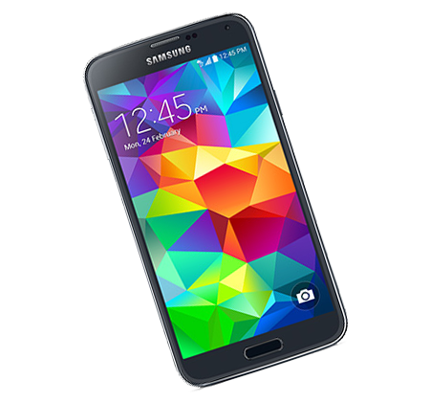
3.1 Scenario Example
Notes:
1. Alice wants to buy a SmartPhone on Ebay. She is willing to pay a certain amount of money for it.

Slide 19
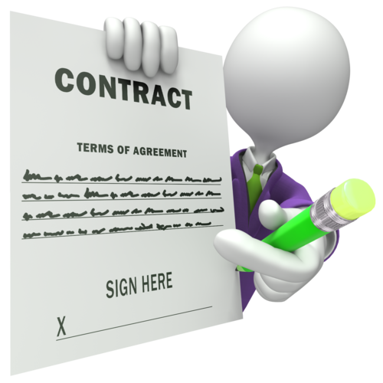
3.1 Scenario Example
Notes:
For buying the smart phone, alice wants to make sure that she would get the product she is paying for. Therefore, she stipulates a TRADITIONAL contract with Bob, an Ebay employee who works in the legal area.

Slide 20
3.1 Scenario Example
Notes:
On the tradictional contract there are the following agreements:
The Phone will be shipped to Alice only once the money transaction has been confirmed.
The middleman Bob, is in charge of checking whether the payment has really been made.
If not, he waits 1-2 days and then he checks the payment again.

Slide 21
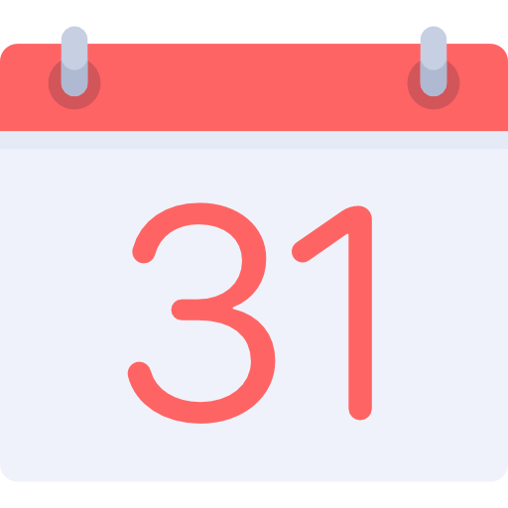


3.1 Scenario Example
Notes:
A better explanation of the contract terms
Alice pays for her Smartphone on a certain day
Bob, doesn’t know when Alice actually paid for her Smartphone. Therefore he checks the payment once in a while.
Might be possible that Alice’s money is already been transferred, but Bob will check it a couple of days later.
- When the payment is confirmed by Bob, the Smartphone will be shipped to Alice.

Slide 22


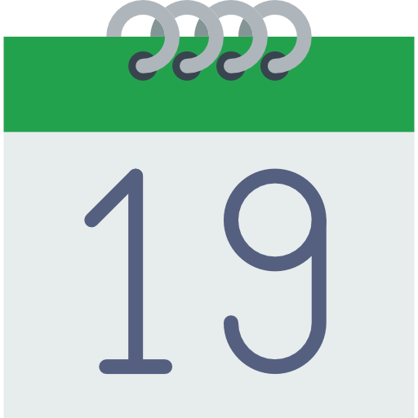
3.1 Scenario Example
Where is
my phone?
Notes:
As you can see, Alice is not happy with this kind of deal. A traditional contract needs always a middleman, who checks and executes the agreed terms defined in the contract.
This process implies always a delay between seller and buyers and implies also some costs for the company (the middleman has to be paid for his work).
A lawyer might be necessary if some party doesn’t comply with the contract.

Slide 23


3.1 Scenario Example
I could use
a Smart Contract!
Notes:
Alice got an idea! She could use a smart contract to make the process faster and better.

Slide 24

3.1 Scenario Example
Notes:
Let’s suppose that Ebay works together with a company which provides some services for Smart Contracts (e.g. Ethereum).
Alice wants to try this new service and stipulates a new SM with Ebay.

Slide 25
3.1 Scenario Example
Notes:
As soon as Alice makes the payment, the SC is triggered and when the payment is confirmed, Ebay will be noticed by the SC and can immediately send the smart phone.
As you can see: the process is istanteneous and there is NO need of a middleman

Slide 26
3.1 Scenario Example
Notes:
Alice chooses a Smart Contract!

Slide 27
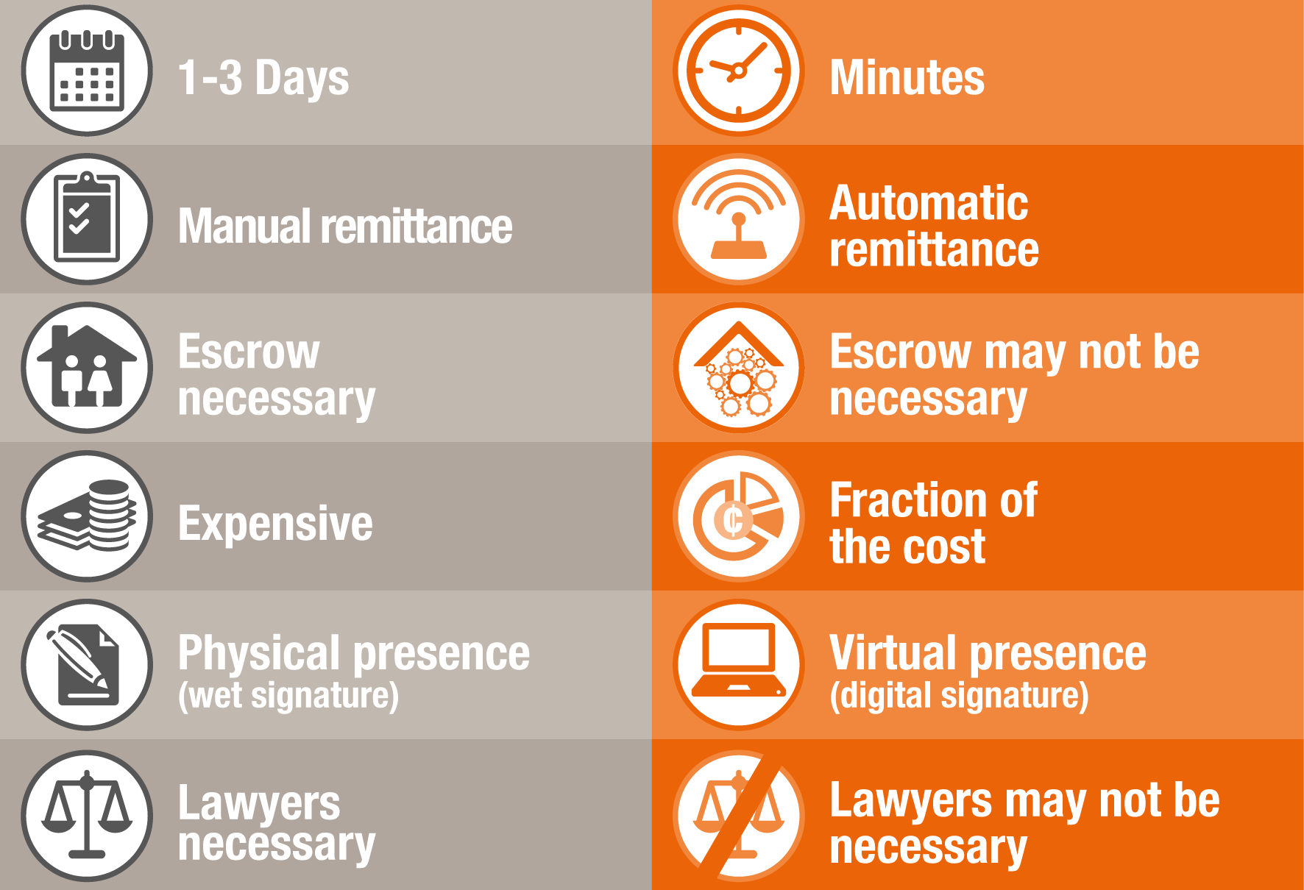
3.2 Traditional ContractS vs. Smart Contracts
TRADITIONAL
SMART
Notes:
http://www.pwc.com/us/en/technology-forecast/blockchain/digital-business.html
According to our example of Alice and Bob the following table shows the main differences between traditional and smart contracts:
The execution of a smart contract doensn’t need a middleman, which mean that can be executed faster
Manual remittance: Ebay is immediately notified
A Smart Contract is for sure cheaper than a traditional one. You don’t have to pay for a middleman who checks the agreements, you have only to pay the ”code”.
A Smart Contract cannot get lost and its always available in chronological order on the blockchain for future access
Like said before, there is no need of a middleman (lawyer)
A Smart contract on a blockchain is like a single large secure Computer System BUT without the risks, costs and trust issues of a centralised model

Slide 28
3.3 What goes into a Smart Contract?
Smart Contracts are composed by fields and functions
If a Smart Contract throws an exception, the execution stops (everything gets reverted)

Slide 29
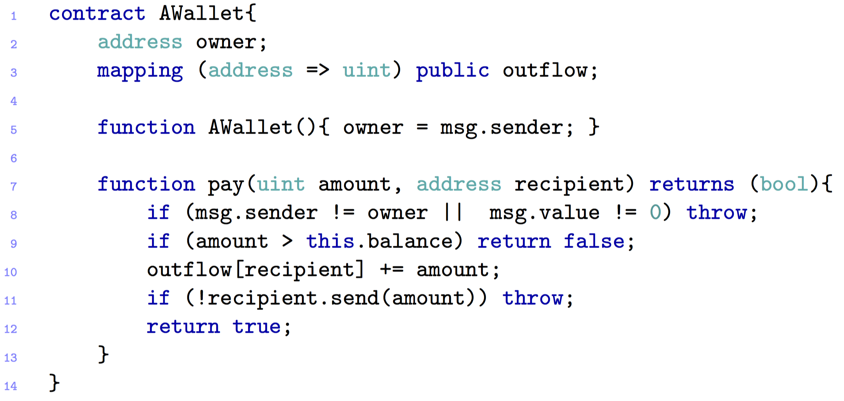
3.3 A simple WALLET CONTRACT
Notes:
This contract is written in Solidity language, which is high-level javascript-based language supported by the Ethereum communtiy.
We are going to explain later in details what Ethereum is and why it is so important for Smart contracts.
EXPLAIN THE CODE:
This snippet implements a personal wallet associated to an owner.
Line 5: Constructor, where the wallet gets associated to its owner
Line 7: Pay function which takes as parameters an amount of cryptovalue and the address of the recipient
Line 8: Exception that gets thrown if the caller is not the owner (the owner is the only one that can logically send his money) or if some ether (cryptovalue used on the Etheruem platform, analogous as Bitcoins) is attached to the invocation and transferred to the contract (se vuoi trasferire degli ether a te stesso mentre evochi questa funzione)
Line 9: the Call returns false if there is not enough amount on the wallet
Line 10: The outflow registry (blockchain) gets updated before the ether is transferred to the recipient.
Line 11: If the recipient is a contract return false

Slide 30
3.4 Possible Applications
Financial services
Coupon payments
Loans (e.g. Leasing)
Life sciences
Electronic medical records
Cross-Industry
Voting
Notes:
Coupon payments: Automatically calculates and pays period coupon payments (for bonds)
Leasings: could be stored as a SC in the blockchain, togheter with some ownership information. If the borrower misses a payment, the SC should automatically revoke the digital keys that grant his access to the collateral. (esempio automobile hardware motore)
Voting: validates voter criteria, logs vote to the blockchain

Slide 31
3.5 Ethereum, Blockchain-based Platform
Fi
Notes:
Coupon payments: Automatically calculates and pays period coupon payments (for bonds)
Leasings: could be stored as a SC in the blockchain, togheter with some ownership information. If the borrower misses a payment, the SC should automatically revoke the digital keys that grant his access to the collateral. (esempio automobile hardware motore)
Voting: validates voter criteria, logs vote to the blockchain

